Slide 1
HamWAN
A modern microwave network for amateur radio

Slide 2
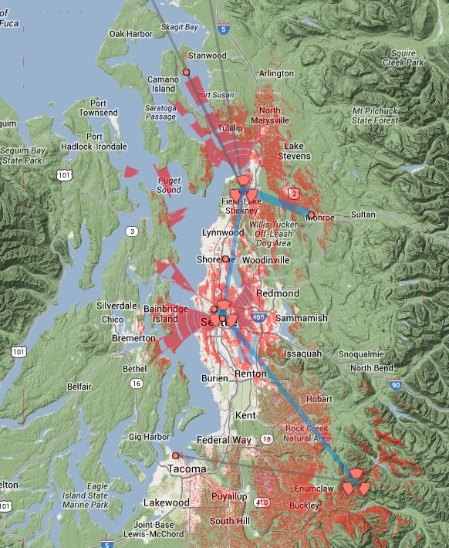
Live and covering the Puget Sound

Slide 3
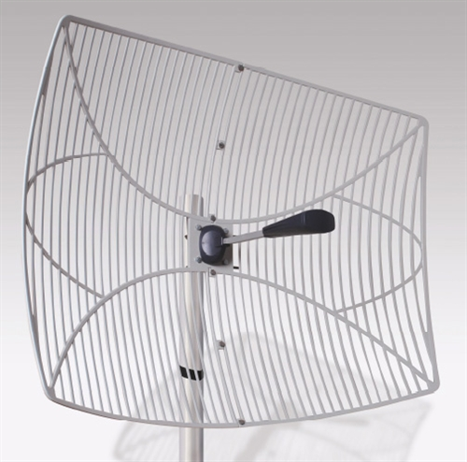
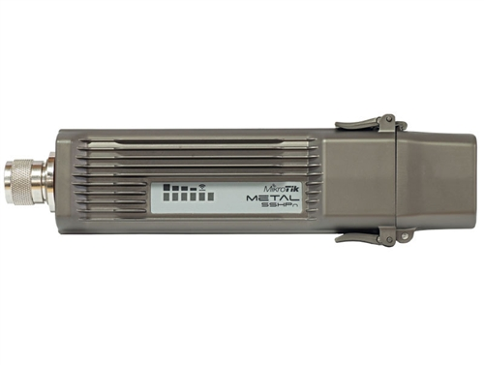
What you need to connect
$86
$81
Total: $167

Slide 4
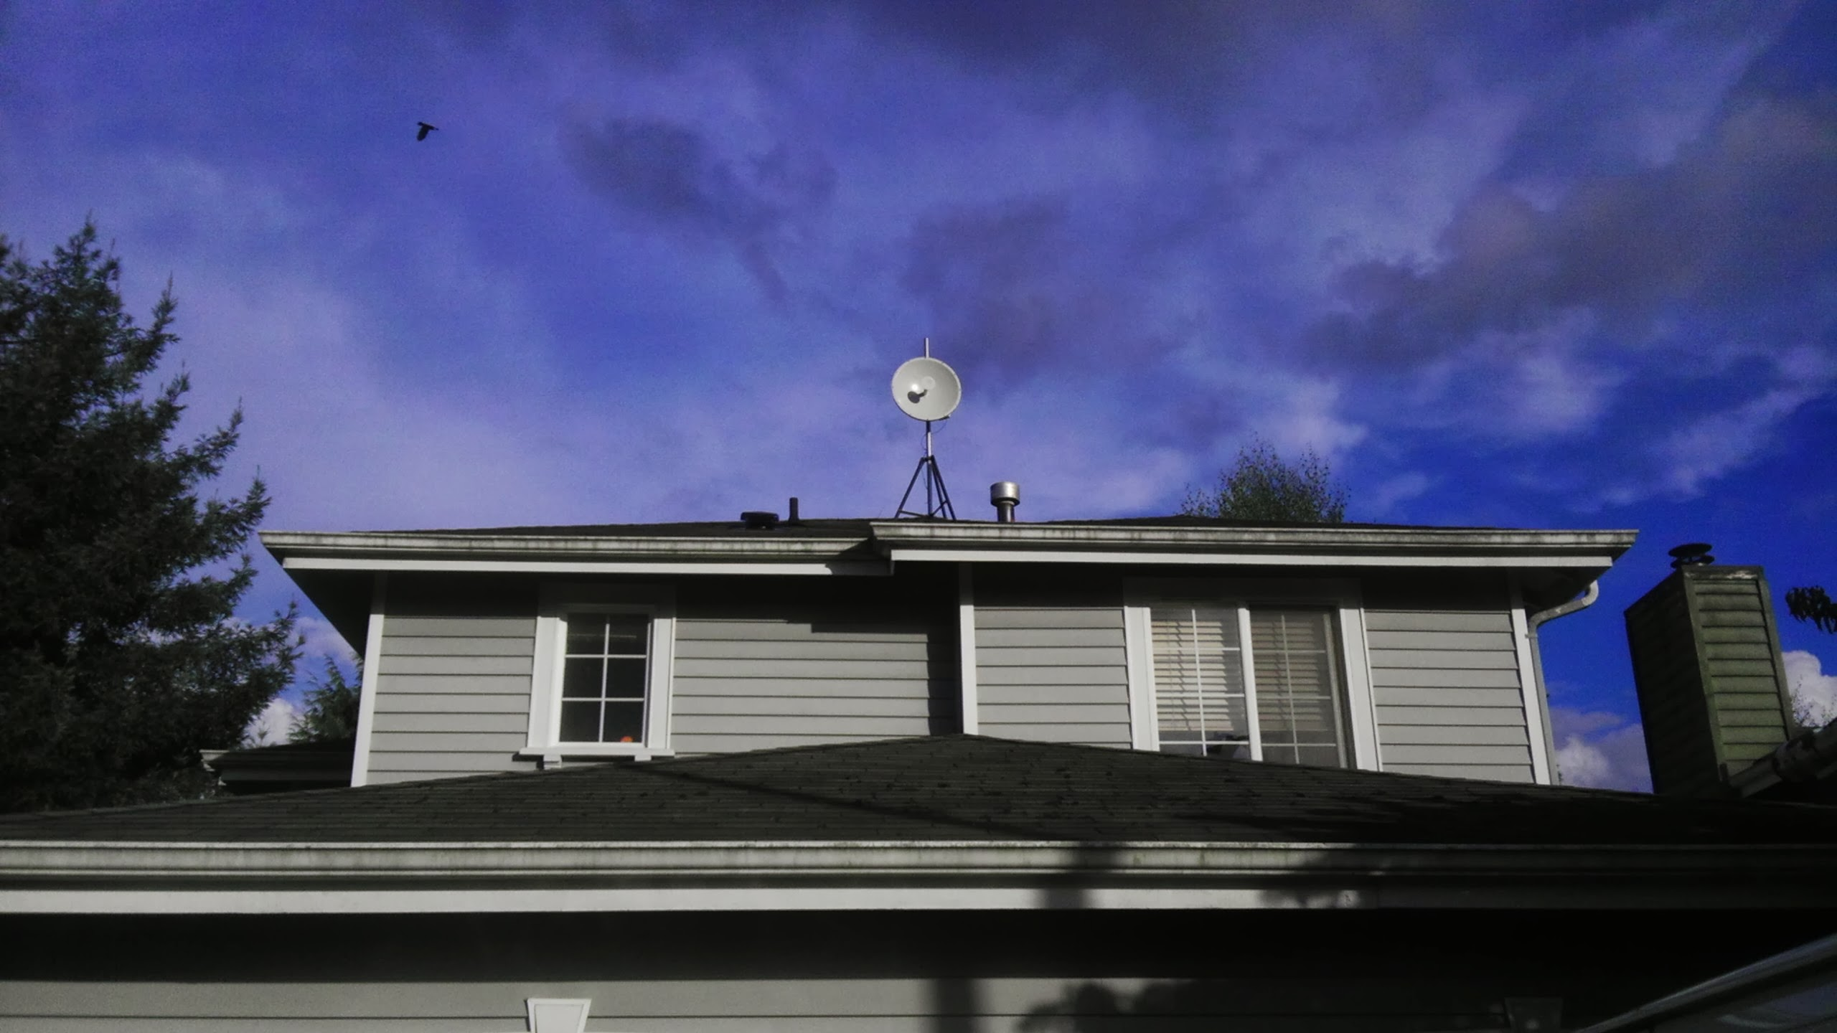
Typical Install

Slide 5
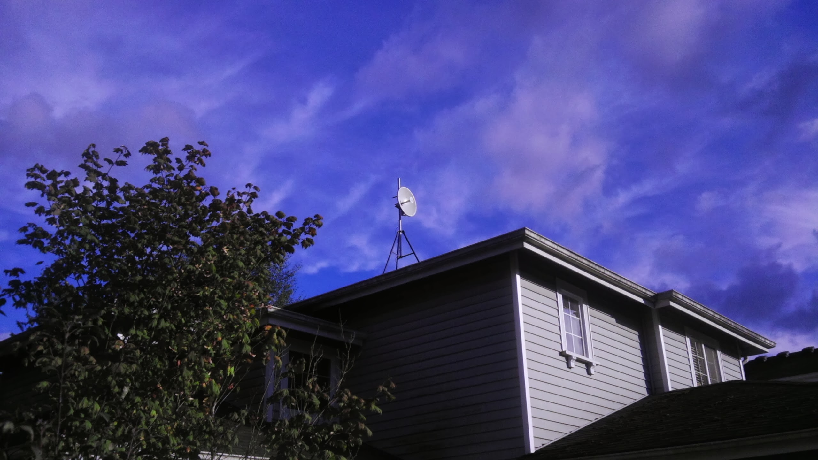
Typical Install

Slide 6
Connection Help
http://webchat.freenode.net/
Join channel #HamWAN

Slide 7
Any non-nerd questions?
(Nerds chill out: more tech info to follow)

